Slide 1
QUERIES OF STOCK MARKET DATABASE
Basic, Intermediate and Advanced

Slide 2
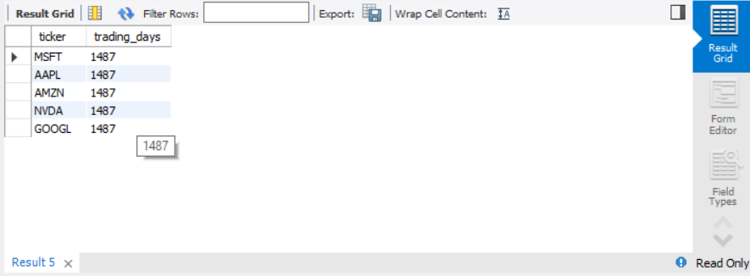
BASIC QUERIES
TRADING DAYS PER STOCK
select ticker, count(*) as trading_days
from stock_data
group by ticker;

Slide 3
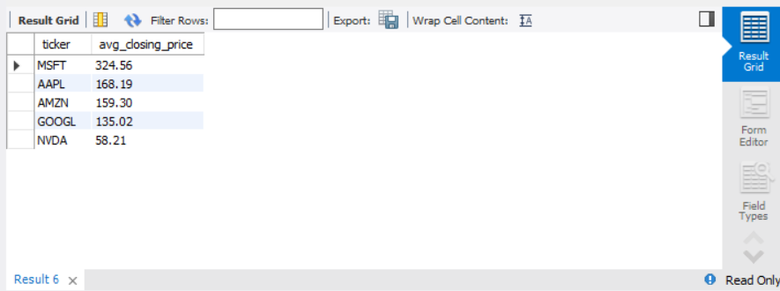
AVERAGE CLOSING PRICE
Select ticker, round(avg(close),2) as avg_closing_price,
From stock_data
Group by ticker
Order by avg_closing_price desc;

Slide 4
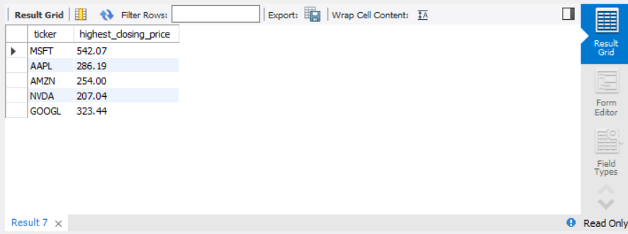
HIGHEST CLOSING PRICE
select ticker, max(close) as highest_closing_price
from stock_data
group by ticker;

Slide 5

LOWEST CLOSING PRICE
select ticker, min(close) as lowest_closing_price
from stock_data
group by ticker
order by ticker asc;

Slide 6

AVERAGE DAILY RETURN
select ticker, round(avg(daily_return),3) as avg_daily_return
From stock_data
Group by ticker
Order by avg_daily_return desc;

Slide 7

AVERAGE VOLUME
SELECT Ticker,
ROUND(AVG(Volume)) Avg_Volume
FROM stock_data
GROUP BY Ticker
ORDER BY Avg_Volume DESC;

Slide 8

MOST VOLATILE STOCK
SELECT Ticker,
ROUND(AVG(Volatility),3) Avg_Volatility
FROM stock_data
GROUP BY Ticker
ORDER BY Avg_Volatility DESC;

Slide 9
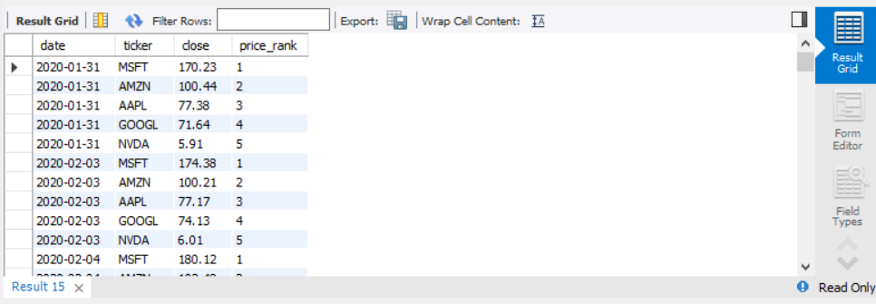
RANK STOCKS BY CLOSING PRICE
Select date, ticker, close,
Rank() over (partition by date order by close desc) as price_rank
From stock_data

Slide 10
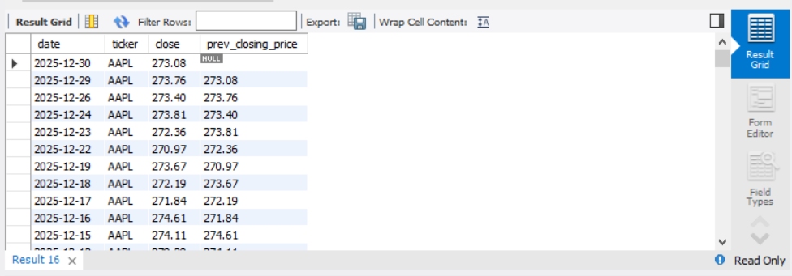
PREVIOUS CLOSING DAY PRICE
Select date, ticker, close,
Lag(close) over (partition by ticker order by date desc) prev_closing_price from stock_data;

Slide 11
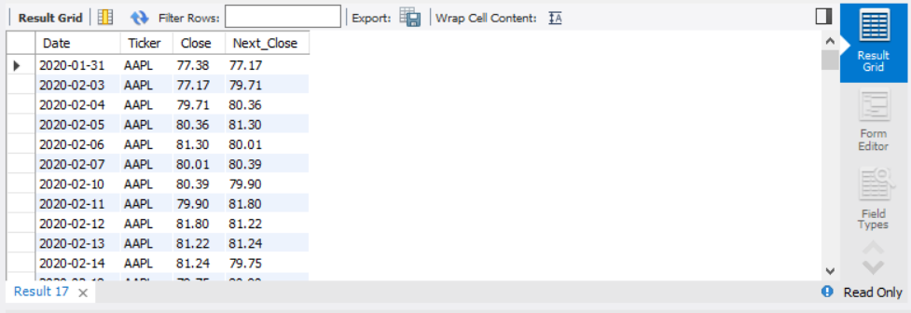
NEXT DAY CLOSING PRICE
select date, ticker,
lead(close) over(partition by ticker order by date) as next_day_closing
From stock_data
Order by next_day_closing desc;

Slide 12
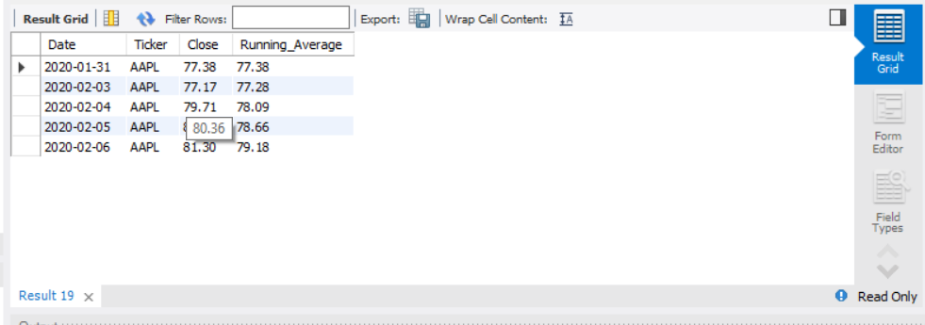
RUNNING AVERAGE
Select ticker, date, close, round (avg(close) over (partition by ticker order by date rows between unbounded preceding and current row) ,2) as running_avg from stock_data ;

Slide 13
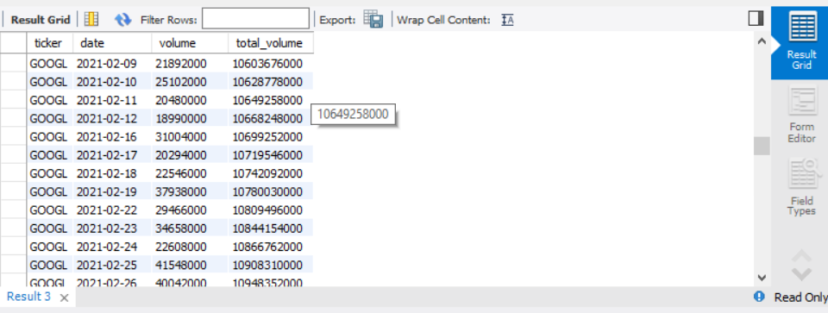
RUNNING TOTAL VOLUME
Select ticker, date, volume,
Sum(volume) over (partition by ticker order by date)
As total_volume
From stock_data;

Slide 14
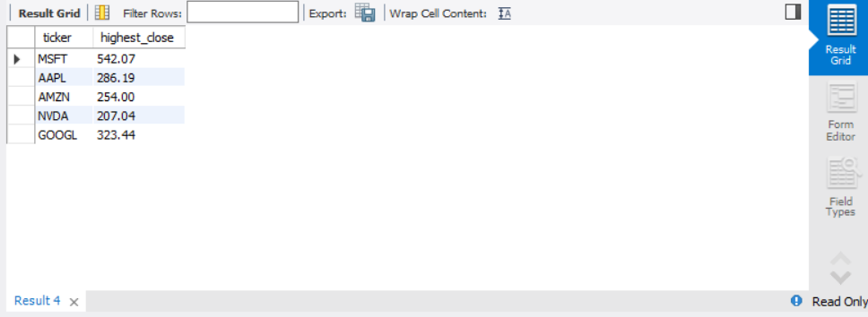
HIGHEST CLOSING PRICE PER STOCK
With high_close as(
Select ticker, max(close) as highest_close
From stock_data
Group by ticker)
Select * from high_close;

Slide 15
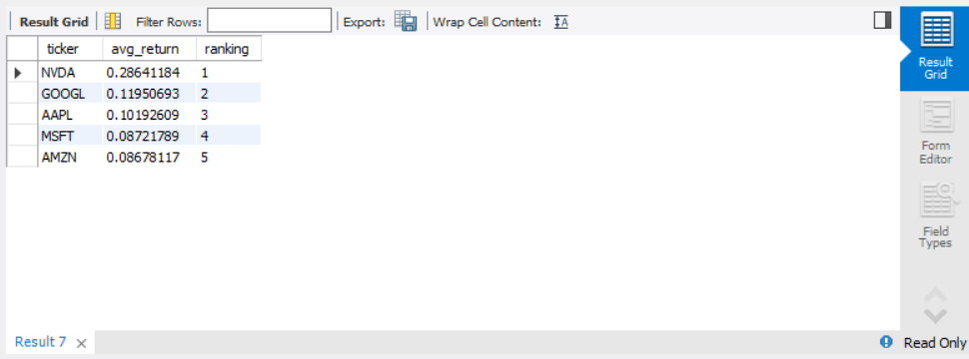
RANK STOCKS BY AVERAGE RETURN
With avg_return as(
Select ticker, avg(return) as avg_return
From stock_data Group by ticker)
Select * ,
Rank() over(order by avg_return desc) as ranking
From avg_return;

Slide 16
FOR EACH YEAR FIND THE HIGHEST ANNUAL CLOSING PRICE
With high_close as(
Select ticker, year( Date) as year_close,
avg(close) as high_annual
From stock_data
Group by year_close, ticker),
ranked as(
select *, rank() over (partition by year_close order by high_annual desc) as rnk
from high_close)
select * from ranked where rnk=1;

Slide 17
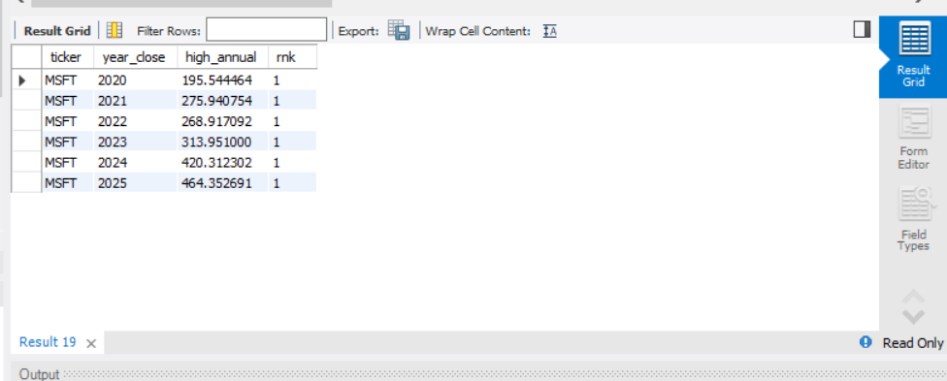

Slide 18
LARGEST ONE DAY PERCENT GAIN IN EACH YEAR
with oneday_gain as(
select ticker,round( 100*close - lag(close) over(partition by ticker order by date) /
lag(close) over(partition by ticker order by date) ,3)as prev
from stock_data),
ranked as(
select*,rank() over (order by prev desc) as rnk
from oneday_gain)
select * from ranked where rnk =1;

